Slide 1
Unit-8 Python with CGI script
Mr. Nilesh Parmar
Assistant Professor, Dept. of Computer Engg.
UVPCE, Ganpat University, Mehsana

Slide 2
CGI
CGI called as ‘Common Gateway Interface’, is a set of standards that define how information is exchanged between the web server (like HTTP server) and a custom script (application program).
The CGI specifications are currently maintained by the NCSA (National Centre for Supercomputing Applications).
The current version is CGI/1.1 and CGI/1.2 is under progress.
Thus, CGI is a standard for writing application programs that can interact with a client (web browser) through an HTTP web server.
In other way, CGI is the standard for application programs to interface with HTTP servers.
These application programs can be a Python Script, PERL Script, Shell Script, C or C++ program etc. Application programs are called as CGI scripts.
These application programs OR CGI scripts reside on webserver. So, CGI programming is also a server side programming.

Slide 3
Concept of CGI
To understand the concept of CGI, let us see what happens when we click a hyper link to browse a particular web page or URL.
Your browser contacts the HTTP web server and demands for the URL, i.e., filename.
Web Server parses the URL and looks for the filename. If it finds that file then sends it back to the browser, otherwise sends an error message indicating that you requested a wrong file.
Web browser takes response from web server and displays either the received file or error message.
When the user (web browser) request a web-page, the web server usually passes this request to all application programs. Those programs process data and send back the response. Then, web server sends this response to user.
To define how information is exchanged between the web server and application program is nothing but CGI (Common Gateway Interface).
This application program can be Python Script, PERL Script, Shell Script, C or C++ program.

Slide 4
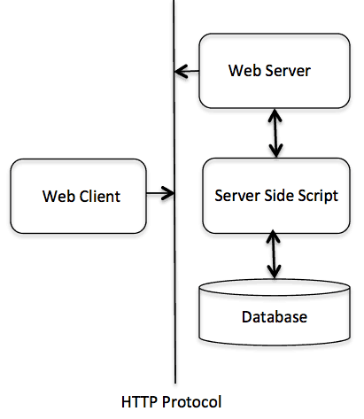
CGI Architecture Diagram

Slide 5
Installation and configuration
To perform CGI programming, we need a HTTP web server.
We will use ‘Apache’ which is a most widely used HTTP web server.
Using, Xampp (or Wampp) software for windows, Apache server can be set up.
Link to download Xampp tool:
https://downloadsapachefriends.global.ssl.fastly.net/7.4.3/xampp-windows-x64-7.4.3-0-VC15-installer.exe?from_af=true
Download and install Xampp server in your system.
To enable CGI support on Xampp server, certain modification must be done in configuration file- 'httpd.conf’. Location of this file is given below:
c:\xampp\apache\conf\httpd.conf
Open this file using notepad.
Perform following modifications in this ‘httpd.conf’ (go to next slide)

Slide 6
Cntd…
1) Look for following block in the file: (open file using notepad)
<Directory />
AllowOverride none
Require all denied
</Directory>
Replace that block with following block:
<Directory />
AllowOverride None
Options ExecCGI
Order allow,deny
Allow from all
</Directory>
2) Locate following statement in that ‘httpd.conf’ file:
AddHandler cgi-script .cgi .pl .asp
Replace that statement with following statement:
AddHandler cgi-script .cgi .pl .asp .py
After performing these 2 steps, now your xampp web server is ready to run python CGI script.
But first we need to understand Syntax and format of python CGI script.

Slide 7
Terminologies
HTTP server-Apache server- Xampp server is installed on our system. That means our system itself work as a server.
When our own system work as a server, it is called as ‘localhost’ (ip address- 127.0.0.1).
Client- It is the web browser of user’s computer, which makes request to server.
Here, you can use any web browser like chrome, firefox, safari, opera, UC browser etc. They will be called as ‘client’.

Slide 8
CGI Script
Python CGI script has two sections
The first section holds headers that tells the client which kind of data is provided as response.
The second section is the HTML. It is used to display formatted text on client software (web browser).
1) Section-1 (HTTP header):
Syntax of HTTP header is given as:
HTTP Field Name: Field Content
Example: One of the headers is “Content-type” and its value is “text/html\r\n\r\n”. It will be written as:
Content-type: text/html\r\n\r\n
Details of other HTTP headers are given in following table.

Slide 9
Cntd…
Sr.No. | Header Name | Description
1 | Content-type: | A MIME string defining the format of the file being returned. Example is Content-type:text/html
2 | Expires: Date | Specifies the date when information becomes invalid. It is used by the browser to decide when a page needs to be refreshed. A valid date string is in the format 01 Jan 1998 12:00:00 GMT.
3 | Location: URL | The URL on which the response must be returned, instead of the URL requested. You can use this field to redirect a request to any file.
4 | Last-modified: Date | The date of last modification of the resource.
5 | Content-length: N | The length, in bytes, of the data being returned. The browser uses this value to report the estimated download time for a file.
6 | Set-Cookie: String | Set the cookie passed through the ‘String’

Slide 10
Cntd…
2) Section-2: This section contains script which renders HTML code to the client browser through Python's print() statements.
Now, Let us write our first CGI program which encompasses both section-1 & 2.
Create file ‘hello.py’ and paste following code in that file:
#!C:\Users\Nilesh\AppData\Local\Programs\Python\Python37\python.exe
import cgi,cgitb
cgitb.enable()
print ("Content-type:text/html\r\n")
print ("<html>")
print ("<head><title>My First CGI-Program </title></head>")
print ("<body>")
print ("<h1>This is HTML's Body </h1>")
print ("</body>")
print ("</html>")
It shows which complier is used
Built in modules- cgi and cgitb are imported. cgitb is used for tracing exceptions.
Enabling the exception tracing feature of cgitb module
Section-1
Section-2

Slide 11
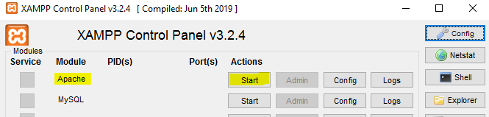
Cntd…
Store this file on following location:
c:\xampp\cgi-bin
Open Xampp control panel (write ‘xampp control panel’ in windows start button and click it). Then start ‘Apache’ server from ‘xampp control panel’.
So, our HTTP webserver in running now. Next we need to open any web browser (chrome, firefox, safari, opera, UC etc.) and write following line as URL:
http://localhost/cgi-bin/hello.py
Press enter. You will be able to see output on browser window.
Note: Now onwards, we will run all the programs in this way, means starting ‘Apache’ server > storing CGI script in ‘cgi-bin’ directory > execute program in browser

Slide 12
CGI Environment variables
CGI environmental variables play an important role while writing any CGI program. All the CGI programs have access to the following environment variables:
Sr. No. | Variable Name | Description
1 | CONTENT_TYPE | The data type of the content. Used when the client is sending attached content to the server. For example, file upload.
2 | CONTENT_LENGTH | The length of the query information. It is available only for POST requests.
3 | HTTP_COOKIE | Returns the set cookies in the form of key & value pair.
4 | HTTP_USER_AGENT | The User-Agent request-header field contains information about the user agent originating the request. It is name of the web browser.
5 | PATH_INFO | The path for the CGI script.
6 | QUERY_STRING | The URL-encoded information that is sent with GET method request.
7 | REMOTE_ADDR | The IP address of the remote host making the request. This is useful logging or for authentication.
8 | REMOTE_HOST | The fully qualified name of the host making the request. If this information is not available, then REMOTE_ADDR can be used to get IR address.
9 | REQUEST_METHOD | The method used to make the request. The most common methods are GET and POST.
10 | SCRIPT_FILENAME | The full path to the CGI script.
11 | SCRIPT_NAME | The name of the CGI script.
12 | SERVER_NAME | The server's hostname or IP Address
13 | SERVER_SOFTWARE | The name and version of the software the server is running.

Slide 13
GET Method
Web browser uses two methods to pass information (or to make request) to web server: GET and POST
The GET method sends the encoded user information by attaching it with the page request. The page and the encoded information are separated by the ? character. For example −
http://www.test.com/cgi-bin/hello.py?key1=value1&key2=value2
The GET method is the default method to pass information from the browser to the web server and it produces a long string that appears in your browser’s URL box.
Never use GET method if you have password or other sensitive information to pass to the server.
The GET method has size limitation: only 1024 characters can be sent in a request string.
The GET method sends information using QUERY_STRING header and will be accessible in your CGI Program through QUERY_STRING environment variable.
You can pass information by simply concatenating key and value pairs along with any URL or you can use HTML <FORM> tags to pass information using GET method.

Slide 14
Example-1 of GET method
Example-1: Let us create an html file named- ‘test.html’. Contents of this file are:
<form action = "/cgi-bin/hello_get.py" method = "get">
First Name: <input type = "text" name = "fn"> <br />
Last Name: <input type = "text" name = "ln"> <br />
<input type = "submit" value = "Submit" />
</form>
Store this html file at location: c:\xampp\htdocs

Slide 15
Example-1 GET method (continue)
Create another file named- ‘hello_get.py’. Contents of this file are:
Store this file at location: C:\xampp\cgi-bin
#!C:\Users\Nilesh\AppData\Local\Programs\Python\Python37\python.exe
import cgi,cgitb
cgitb.enable()
fs= cgi.FieldStorage()
first_name=fs.getvalue('fn')
last_name=fs.getvalue('ln')
print ("Content-type:text/html\r\n")
print ("<html>")
print ("<head><title>My CGI-Program</title></head>")
print ("<body>")
print ("Hello %s %s"%(first_name,last_name))
print ("</body>")
print ("</html>")
The cgi module has a FieldStorage class. The data received
from client request is collected in FieldStorage object.
getvalue() method of FieldStorage class fetches values using ‘name’ parameter of HTML tag
Displaying fetched values inside body tag

Slide 16
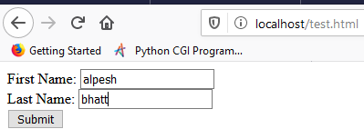

Example-1 GET method (continue)
Now, start ‘Apache’ server from xampp control panel. Open any browser and write following line as URL: http://localhost/test.html
It shows webpage like this:
Click on submit button and it will redirect to file ‘hello_get.py’. It shows following output:
Here, in URL you can see that ‘fn’ and ‘ln’ parameters and their values are part of URL (shown in blue underline). This is the final output of example-1. Let us see another example of GET method.

Slide 17

Example-2 GET method
Instead of passing values to CGI script (in out case, python script-hello_get.py) using html form, we can send direct values to CGI script also.
Keep contents of file-‘hello_get.py’ same as we kept in example-1.
Start ‘Apache’ server and write following URL:
http://localhost/cgi-bin/hello_get.py?fn=raman&ln=soni
Press Enter. You will get output like this:
Here, we are providing values of ‘fn’ and ‘ln’ attributes to python CGI script without any html form, but directly using URL that you can check in URL part written after ‘?’ character.

Slide 18
POST method
A generally more reliable method of passing information to a CGI program is the POST method. If we are sending information like password or bank PIN number, we must use POST method.
POST method packages the information in exactly the same way as GET method does, but instead of sending it as a text string after ‘?’ character in the URL, it sends it as a separate message. This message comes to the CGI script in the form of the standard input.
Example of POST method: Let us consider same files ‘test.html’ and ‘hello_get.py’ which we considered in Example-1 of GET method. There is only one difference in ‘test.html’ file- method name is ‘post’. Contents of ‘test.html’ file are:
<form action = "/cgi-bin/hello_get.py" method = "post">
First Name: <input type = "text" name = "fn"> <br />
Last Name: <input type = "text" name = "ln"> <br />
<input type = "submit" value = "Submit" />
</form>
Contents of ‘hello_get.py’ are same.

Slide 19
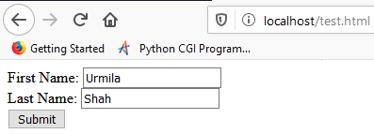

Cntd…
Start ‘Apache’ server and write following URL in any browser:
http://localhost/test.html
It will show webpage like this:
Click on submit button and it will redirect on ‘hello_get.py’ and output will be shown as:
Here, we can see that parameters ‘fn’ and ‘ln’ and their values are not part of URL. But they are sent as a separate message to CGI python script which captures it as a Standard Input. Now, we have to understand ‘FieldStorage’ class in depth.

Slide 20
FieldStorage class
This class of cgi module is used to fetch data from HTML controls. The data received from client request is collected in FieldStorage object. This is similar to Python's dictionary object consisting of form elements and their respective values.
Once the form data is retrieved by FieldStorage object on server side, the Python CGI script can perform further processing and render HTML output back to the client browser.
Attributes associated with FieldStorage class are:
Sr. No. | Attribute | Description
1 | name | The field name
2 | filename | Client side filename.
3 | value | The value as a string. For file uploads, reads the file and returns bytes
4 | file | The file(-like) object from which you can read the data as bytes
5 | type | The content-type
6 | headers | A dictionary(-like) object containing all headers

Slide 21
Cntd…
Methods associated with FieldStorage class are:
Sr. No. | Method | Description
1 | getfirst() | Return the first value received.
2 | getlist() | Return list of received values.
3 | getvalue() | Dictionary style get() method.
4 | keys() | Dictionary style keys() method.
5 | make_file() | Return a readable & writable file.

Slide 22
Working with different HTML controls 1) checkbox
If we keep check boxes in html file then how HTTP server will handle it with the help of Python CGI script, that we need to understand.
Let us take an example. Consider ‘test.html’ file with following contents:
<form action = "/cgi-bin/checkbox.py" method = "POST" target = "_blank">
<label> Student Details:</label><br/>
<input type = "checkbox" name = "maths" value = "maths" /> Maths
<input type = "checkbox" name = "physics" value = "physics" /> Physics <br/>
<input type = "submit" value = "Submit Subject" />
</form>
As usual, test.html is stored in: c:\xampp\htdocs

Slide 23
Cntd…
Contents of file ‘checkbox.py’ are:
#!C:\Users\Nilesh\AppData\Local\Programs\Python\Python37\python.exe
import cgi,cgitb
cgitb.enable()
fs= cgi.FieldStorage()
m=fs.getvalue('maths')
p=fs.getvalue('physics')
t=''
if m:
t=t+m+' '
if p:
t=t+p
print ("Content-type:text/html\r\n")
print ("<html>")
print ("<body>")
print ("You have selected: %s"%t)
print ("</body>")
print ("</html>")
As usual, location of ‘check.py’ is : c:\xampp\cgi-bin

Slide 24
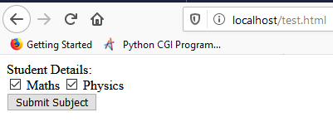
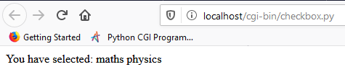
Cntd…
Start ‘Apache’ server and write following URL:
http://localhost/test.html
It displays:
When you click “submit subject” button, Output is:
Note: You can select any one option also like select only maths or only physics.
This is the response of Python CGI script when html code contains checkbox.

Slide 25
2) Radio button, Multiline text and Dropdown list
Contents of HTML file- ‘test.html’ are given below: (location: c:\xampp\htdocs)
<form action = "/cgi-bin/python_cgi.py" method = "POST" target = "_blank">
<label> Student Details:</label><br/>
<input type = "radio" name = "gender" value = "male" /> Male
<input type = "radio" name = "gender" value = "female" /> Female <br/>
Address: <br/>
<textarea name="address" cols="20" rows="3"></textarea><br/>
<select name="year">
<option value="first year" >first year</option>
<option value="second year" selected>second year</option>
<option value="third year">third year</option>
<option value="fourth year">fourth year</option>
</select><br/>
<input type = "submit" value = "Submit Data" />
</form>

Slide 26
Contents of CGI file-‘python_cgi.py’ are given below: (location: c:\xampp\cgi-bin)
#!C:\Users\Nilesh\AppData\Local\Programs\Python\Python37\python.exe
import cgi,cgitb
cgitb.enable()
fs= cgi.FieldStorage()
m=fs.getvalue('gender')
n=fs.getvalue('address')
o=fs.getvalue('year')
print ("Content-type:text/html\r\n")
print ("<html>")
print ("<body>")
print ("You have selected: %s"%m)
print("<br>")
print ("Your address: {0}".format(n))
print("<br>")
print ("You are student of: ", o)
print ("</body>")
print ("</html>")

Slide 27
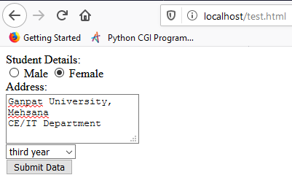
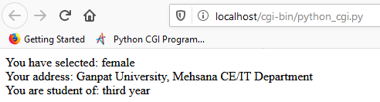
Cntd…
Start ‘Apache’ server and run URL: http://localhost/test.html
It displays :
When you click “submit Data” button, output will be:

Slide 28
3) File Upload
To upload a file, the HTML form must have the ‘enctype’ attribute with value ‘multipart/form-data’. The input tag with the ‘type’ parameter having value ‘file’ creates a "Browse" button.
Create a file named- ‘test.html’. Contents of this file are:
<form enctype="multipart/form-data" action = "/cgi-bin/save_file.py" method = "post">
<p>File: <input type = "file" name = "file_name"> <br />
<input type = "submit" value = "Upload" /></p>
</form>
Location of file is: c:\xampp\htdocs

Slide 29
Contents of python CGI script file- ‘save_file.py’ are given below: (Location: c:\xampp\cgi-bin)
#!C:\Users\Nilesh\AppData\Local\Programs\Python\Python37\python.exe
import cgi,cgitb,pathlib
cgitb.enable()
fs=cgi.FieldStorage()
fn=fs['file_name']
if fn.filename:
fl=open("C:/Users/Nilesh/"+fn.filename,"wb")
#fl=open(pathlib.Path.cwd()/fn.filename,"wb")
m=fn.file.read()
fl.write(m)
print ("Content-type: text/html\n")
print ("""<html>
<body>""")
print("File successfully uploaded")
print ("""</body>
</html>""")
This is general code for uploading file in current working directory.

Slide 30
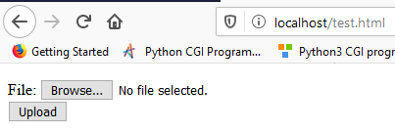
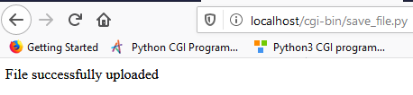
Cntd…
Start ‘Apache’ server and execute following link on any browser:
http://localhost/test.html
It will display:
If you browse any file from your system and press “Upload”, you will be able to see following output:
Here, no error means file successfully uploaded on location- C:/Users/Nilesh

Slide 31
4) File Download
Sometimes, we want to give an option where user can click a button (or link) and one "File Download" dialogue box pops up to provide service of file downloading.
This can be achieved through HTTP header. This HTTP header is different from the header used in previous all examples:
Content-Disposition: attachment; filename = \"FILENAME\"\n"
FILENAME is name of the file which will become downloadable by user.
We are going to use 3 files:
test.html- which provides “download” button to user. Location: c:\xampp\htdocs
download_file.py- Python CGI file which provides file downloading facility with the help of “File Download” dialog box. Location: c:\xampp\cgi-bin
nba.txt- User will download this file. Location: c:\xampp\cgi-bin

Slide 32
Contents of ‘test.html’ are:
<form action = "/cgi-bin/download_file.py" method = "post">
File is ready for download.<br /><br/>
<input type = "submit" value = "Download" />
</form>
Contents of file ‘download_file.py’ are:
#!C:\Users\Nilesh\AppData\Local\Programs\Python\Python37\python.exe
import cgi,cgitb
cgitb.enable()
print ("Content-Disposition: attachment; filename = \"nba.txt\"\n")
# Actual File Content will go here.
fo = open('nba.txt', "r")
string = fo.read()
print(string)
# Close opened file
fo.close()
This is name will appear in File
Download Dialog box
This is the actual file which contents will be read and downloaded

Slide 33
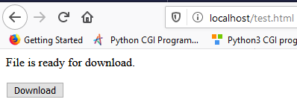
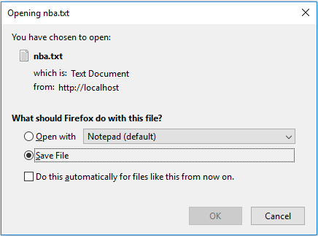
Cntd…
Start ‘Apache’ server and execute following link: http://localhost/test.html
It will display:
When you click on “Download” button, it will show output like this:
This is a “File Download” dialog box. If you click on “Ok” button, it will start downloading file.
File will be stored in the folder whose default path is specified by your web browser. Generally, that folder is “Downloads”.
Note: The file which needs to be downloaded, must be stored in the current working directory means in the directory where ‘download_file.py’ is located.

Slide 34
Cookies in CGI
HTTP protocol is a stateless protocol. For a commercial website, it is required to maintain session information among different web pages. For example, one user browses many web pages of a website, then how to maintain user's session information across all the web pages?
In many situations, using cookies is the most efficient method of remembering and tracking preferences, purchases, commissions, and other information required for better visitor experience or website statistics.

Slide 35
How Cookie works?
Your server sends some data to the visitor's browser in the form of a cookie. The browser may accept the cookie. If it does, it is stored as plain text record on the visitor's hard drive. Now, when the visitor arrives at another page on your site, the cookie is retrieved. After retrieval, your server knows/remembers what was stored.
Cookies are plain text data which store 4 variable-length fields:
expires − The date the cookie will expire. If this is blank, the cookie will expire when the visitor quits the browser.
domain − The domain name of your site.
path − The path to the directory or web page that sets the cookie. This may be blank if you want to retrieve the cookie from any directory or page.
secure − If this field contains the word "secure", then the cookie may only be retrieved with a secure server. If this field is blank, no such restriction exists.
Remember, Cookies are set and retrieved in the form of key and value pairs.
Syntax: name=value

Slide 36
Setting up Cookies
It is very easy to send cookies to browser. These cookies are sent using HTTP header- ‘Set-Cookie’ after ‘Content-type’ header. Assuming you want to set name, password and expires parameters as cookies. Setting the cookies is done as follows −
Here, we are using 3 files:
test.html - location: c:\xampp\htdocs
cookie_set.py - This file is used to set cookies by web server. Location: c:\xampp\cgi-bin
cookie_get.py - This file is used to retrieve cookies stored by web server. Location: c:\xampp\cgi-bin
Contents of ‘test.html’ are as follows:
<form action = "/cgi-bin/cookie_set.py" method = "post" target="_blank">
First Name: <input type = "text" name = "fn"> <br />
Last Name: <input type = "text" name = "ln"> <br />
<input type = "submit" value = "Submit" />
</form>

Slide 37
Contents of file ‘cookie_set.py’ are:
#!C:\Users\Nilesh\AppData\Local\Programs\Python\Python39\python.exe
import cgi,cgitb
cgitb.enable()
fs= cgi.FieldStorage()
m=fs.getvalue('fn')
n=fs.getvalue('ln')
print ('Content-Type: text/html')
print ('Set-Cookie: name=Nilesh')
print ('Set-Cookie: password=Parmar')
print('Set-Cookie: expires=Wed, 08 Apr 2020 18:30:00 GMT\n')
print ("""<html>
<head>
<title>Python CGI cookies Set</title></head>
<body>""")
print("Hello",m,n,"<br>")
print("Your cookies are successfully set. <br>")
print("""</body>
</html>""")
‘\n’ specifies end of header part (section-1) and starting of body part (section-2)

Slide 38
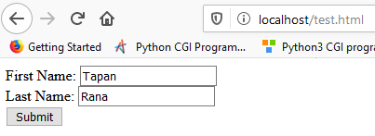
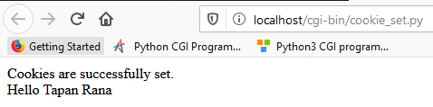
Cntd..
If you see contents of ‘cookie_set.py’, we have set name, password and expires parameter using ‘Set-Cookie’ HTTP header.
Start ‘Apache’ server and execute this URL on any browser: http://localhost/test.html
It will display:
When you click “submit” button, It gives you output:
Code successfully executed, means cookies have been stored (set up).

Slide 39
Retrieving Cookies
To summarize, when we clicked ‘submit’ button of web page ‘test.html’, browser (client) sent request to HTTP server (apache) to provide required data. Here, our server is localhost i.e. our own computer works as server. So, when server provides response to browser (client), it also sends some session information in terms of ‘cookies’ to browser (client) which is stored in user’s (client) computer. In our case, user (client) and server both are our (same) computer. So, cookies sent by server are stored in our system only.
It is very easy to retrieve all the stored (set) cookies. Cookies are stored in CGI environment variable ‘HTTP_COOKIE’ and they will have following form :
key1 = value1; key2 = value2; key3 = value3....
To retrieve cookies, we will execute python CGI script- cookie_get.py

Slide 40
Contents of file ‘cookie_get.py’ are:
#!C:\Users\Nilesh\AppData\Local\Programs\Python\Python37\python.exe
import os
import http.cookies
print ("Content-type: text/html\n")
print ("""<html>
<head>
<title>Python CGI cookies Get</title></head>
<body>
Retrieved cookie details:<br/><br/> """)
if 'HTTP_COOKIE' in os.environ:
cookie_string=os.environ.get('HTTP_COOKIE')
for e in cookie_string.split('; '):
temp=e.split('=')
print(temp[0], ':',temp[1])
print("<br>")
print ("""</body>
</html>""")
Python built-in module to access cookies

Slide 41
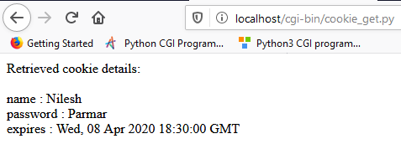
Cntd…
Start ‘Apache’ server and run following URL :
http://localhost/cgi-bin/cookie_get.py
Output will be:
This output shows retrieved cookies, which were stored by HTTP server-localhost (our own computer) on the client machine (again our own system).
Note: If you delete cookies by going into web browser’s settings menu, and if you run this file ‘cookie_get.py’ again, it will display nothing. Because, stored cookies are deleted.

